Slide 1
COM2501 Scientific Programming
MATLAB
Ankara University
Computer Engineering Department

Slide 2
Special cases: vectors and scalars
A vector is a special case of a matrix, with just one row or one column
>> u = [1 3 9] produces a row vector
>> v = [1; 3; 9] produces a column vector

Slide 3
Matrices
 | 2 | 5 | 7 | 8
 | 5 | 6 | 8 | 3
 | 1 | 6 | 4 | 0
Matrix
MATLAB input command
>> A = [2 5 7 8; 5 6 8 3; 1 6 4 0]

Slide 4
Indexing (or Subscripting)
» A =[1 2 3; 4 5 6; 7 8 8]
A =
1 2 3
4 5 6
7 8 8
» A(2, 3)
ans =
6
» A(3, 3) = 9
A =
1 2 3
4 5 6
7 8 9

Slide 5
Indexing (or Subscripting)
» B = A(2:3, 1:3)
B =
4 5 6
7 8 9
» B = A(2:3, :)
B =
4 5 6
7 8 9
» B(:, 2) = []
B =
4 6
7 9
A =
1 2 3
4 5 6
7 8 9

Slide 6
Deleting a row or column
Any row(s) or column(s) of a matrix can be de- leted by setting the row or column to null vector
A(2, :) = [ ] deletes the 2nd row of matrix A
A(:, 3:5) = [ ] deletes the 3rd through 5th columns
A([1 3], :) = [ ] deletes the 1st and the 3rd row of A

Slide 7
Dimensioning
No explicit dimension declarations are required
MATLAB creates a matrix just big enough.
If the matrices B and C do not exist already
B(2, 3) = 5; produces
 | 0 | 0 | 0
 | 0 | 0 | 5

Slide 8
Dimensioning
» C(3, 1:3) = [1 2 3]
C =
0 0 0
0 0 0
1 2 3
» size(C)
ans =
3 3
» [m, n] = size(C)
m =
3
n =
3

Slide 9
Matrix Manipulation
Transpose of matrix A
  Obtained by typing A'
  » A=[2 3; 6 7]
  A =
  2 3
  6 7
  » B = A'
  B =
  2 6
  3 7

Slide 10
Appending a row or column
» A =[1 0 0; 0 1 0; 0 0 1]
A =
1 0 0
0 1 0
0 0 1
» v =[2; 3; 4]
v =
2
3
4
» A = [A v]
A =
1 0 0 2
0 1 0 3
0 0 1 4
» A = [1 0 0; 0 1 0; 0 0 1]
A =
1 0 0
0 1 0
0 0 1
» u = [5 6 7]
u =
5 6 7
» A = [A; u]
A =
1 0 0
0 1 0
0 0 1
5 6 7

Slide 11
Utility matrices
eye(m, n) returns an m x n matrix with
1’s on the main diagonal
zeros(m, n) returns an m x n matrix of zeros
ones(m, n) returns an m x n matrix of ones
rand(m, n) returns an m x n matrix of random numbers
diag(v) generates a diagonal matrix with
vector v on the diagonal
diag(A) extracts the diagonal of matrix A
as a vector

Slide 12
Utility matrices
» B = [ones(3) zeros(3, 2); zeros(2, 3) 4*eye(2)]
B =
1 1 1 0 0
1 1 1 0 0
1 1 1 0 0
0 0 0 4 0
0 0 0 0 4
» diag(B)'
ans =
1 1 1 4 4

Slide 13
Matrix and Array Operations
A+B or A-B is valid if A and B are of the
same size
A*B is valid if A’s number of columns
equals B’s number of rows
A/B is valid, and equals A.B⁻¹ for same
size square matrices A & B
A^2 makes sense only if A is square
and equals A*A

Slide 14
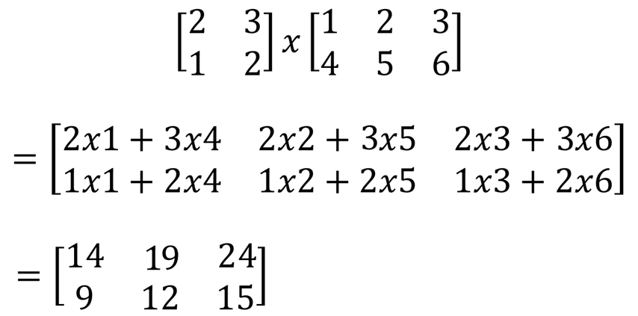
Matrix multiplication

Slide 15
Matrix and Array Operations
Element-by-element multiplication, division and exponentiation between two matrices or vectors of the same size are done by preceding the corresponding arithmetic operators by a period (.):
.* element-by-element multiplication
./ element-by-element right-division
.\ element-by-element left-division
.^ element-by-element exponentiation

Slide 16
Matrix and Array Operations
» v = [ 1 2 3 4 5 6]
v =
1 2 3 4 5 6
» 1./v

Slide 17
Matrix and Array Operations
» v = [ 1 2 3 4 5 6]
v =
1 2 3 4 5 6
» 1./v
ans =
1.0000 0.5000 0.3333 0.2500 0.2000 0.1667

Slide 18
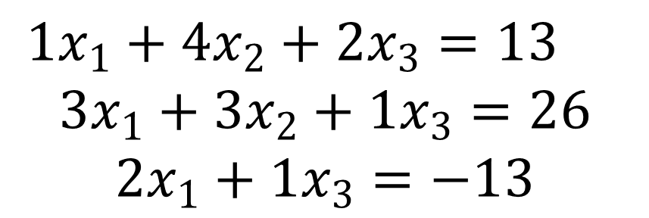
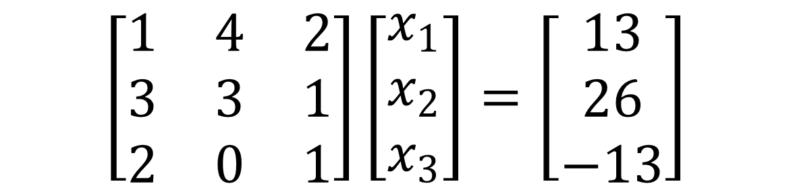
Linear equations

Slide 19
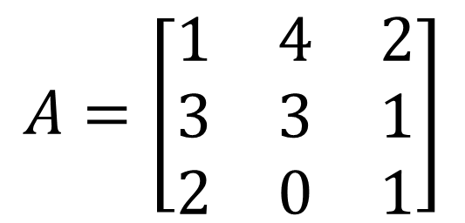
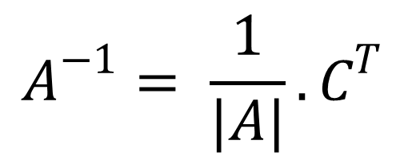
a
a
a
a
a
a
a
22
23
−
a
21
23
+
a
21
22
11
a
a
12
a
a
13
a
a
32
33
31
33
31
32
3
1
3
1
3
3
=
1
−
4
+
2
0
1
2
1
2
0
= 3 – 4 – 12 = – 13

Slide 20
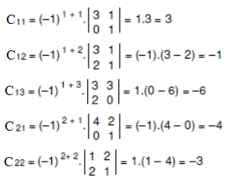
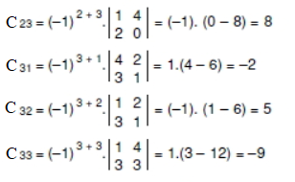
C_{ij} = (-1)^{i+j} ⏐minor(A_{ij})⏐

Slide 21
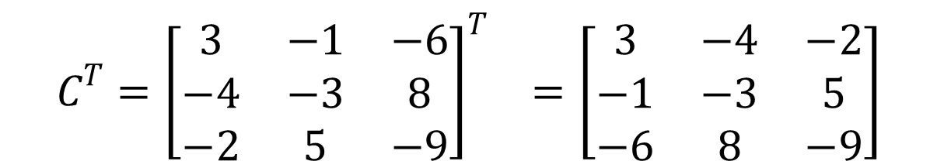
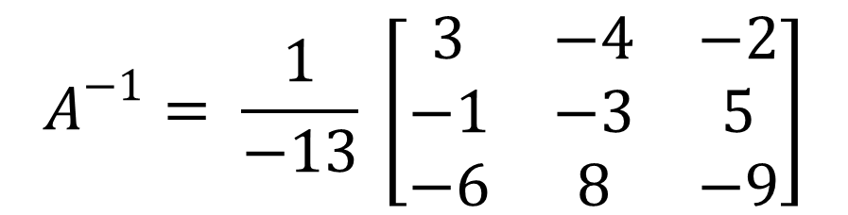

Slide 22
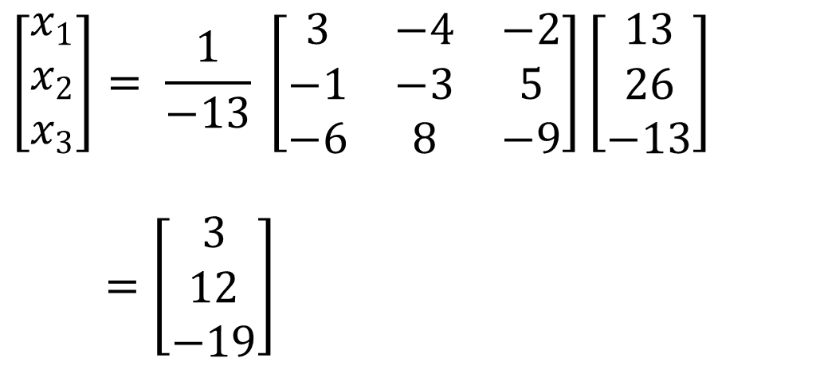
X = A⁻¹ B

Slide 23
IF statement
IF ... END
IF ... ELSE ... END
IF ... ELSEIF ... ELSE ... END
IF A=B
...
ELSEIF C>D+1
...
END
IF A=B
...
ELSE
IF C>D+1
...
END
END

Slide 24
#include<stdio.h>
int main()
{
int grade;
int pass;
grade=80;
if(grade>60)
pass=1;
else
pass=0;
printf(“%d”, pass);
return 0;
}

Slide 25
#include<stdio.h>
int main()
{
int grade;
int pass;
grade=80;
if(grade>60)
pass=1;
else
pass=0;
printf(“%d”, pass);
return 0;
}
grade=80;
if grade>60
pass=1;
else
pass=0;
end
pass

Slide 26
FOR statement
FOR var = expr
...
END
FOR var = expr
...
BREAK
...
END

Slide 27
for a = 10:20
a
end
for a = 1.0: -0.1: 0.0
disp(a)
end
for a = [24,18,17,23,28]
disp(a)
end

Slide 28
WHILE statement
WHILE expr
...
END
WHILE expr
...
BREAK
...
END
a = 10;
while a < 20
disp(a)
a = a + 1;
end

Slide 29
Interactive input/output
r = INPUT('msg')
» r = input('give a number: ')
give a number: 1+12
r =
13

Slide 30
Some MATLAB commands
who List known variables
whos List known variables plus their size
help Ex: >> help sqrt Help on using sqrt
lookfor Ex: >> lookfor sqrt
Search for keyword sqrt in m-files
clear Clear all variables from work space
clear x y Clear variables x and y from work space
clc Clear the command window

Slide 31
Some MATLAB commands
what List all m-files in current directory
dir List all files in current directory
ls Same as dir
type test Display test.m in command window
delete test Delete test.m
which test Display current directory path to test.m
cd a: Change directory to a:
chdir a: Same as cd
pwd Show current directory

